Slide 1
HIRING PROCESS ANALYTICS
-STATISTICS

Slide 2
PROJECT DESCRIPTION:
The project is all about analyzing company’s hiring process data and draw the meaningful insights from it.The Hiring process is crucial function for a company,and understanding trends such as number of rejections,job types,offered salaries can provide valuable insights for hiring department.
The project data is given in excel sheet,it should be cleaned and make it ready to analyze the data.

Slide 3
TECH STACK USED:
SOFTWARE: MICROSOFT 365 WEB:
I used microsoft 365 web(EXCEL) online website to perform the excel operations.As the excel app is paid platform,I have used the online free site.It had all the operations of new version of excel(2021).
OPERATING SYSTEM: MacOS
My device is MacOs.I have used it as it is stable and efficient.

Slide 4
APPROACH:
DATA CLEANING:
The team has given us one dataset(excel) with name Statistics.
The given data was not cleaned and preprocessed,that means it is not ready to analyze.
So I have started the project by Cleaning the Dataset.
First I made the table by using the data columns provided,then checked for blank values in each column.

Slide 5
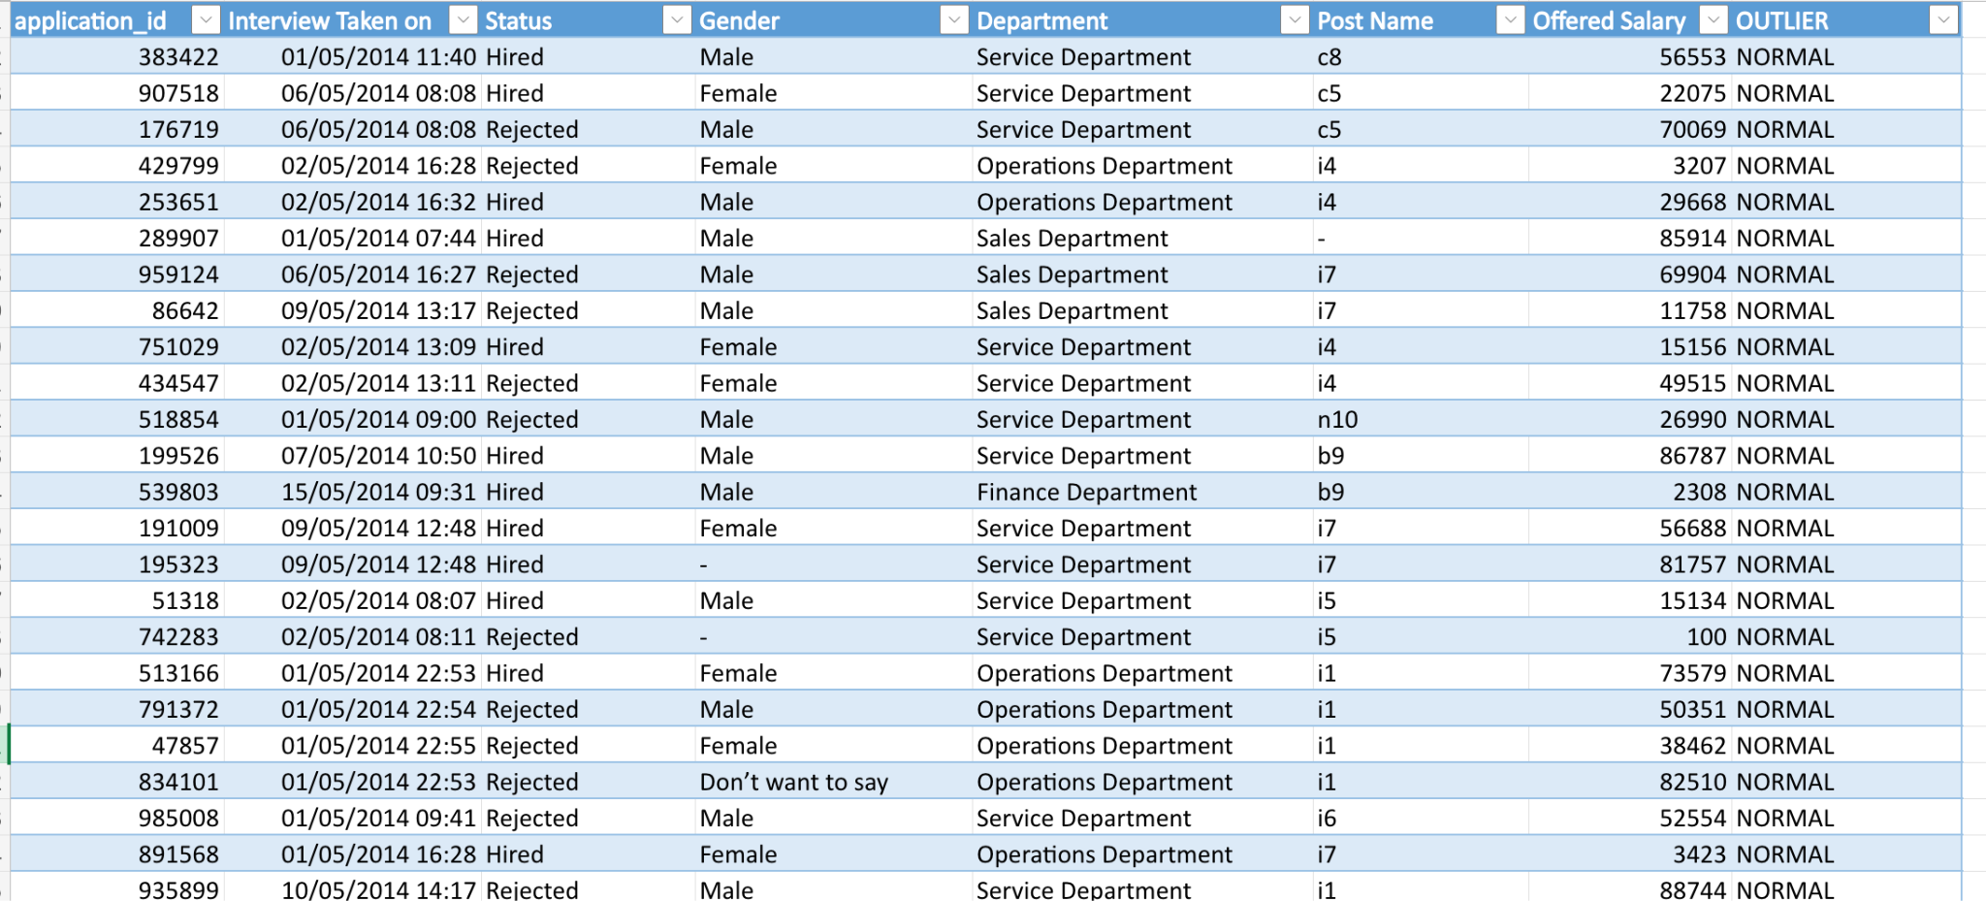
Created the table using the dataset,

Slide 6
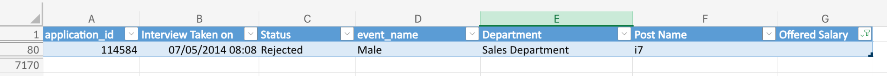
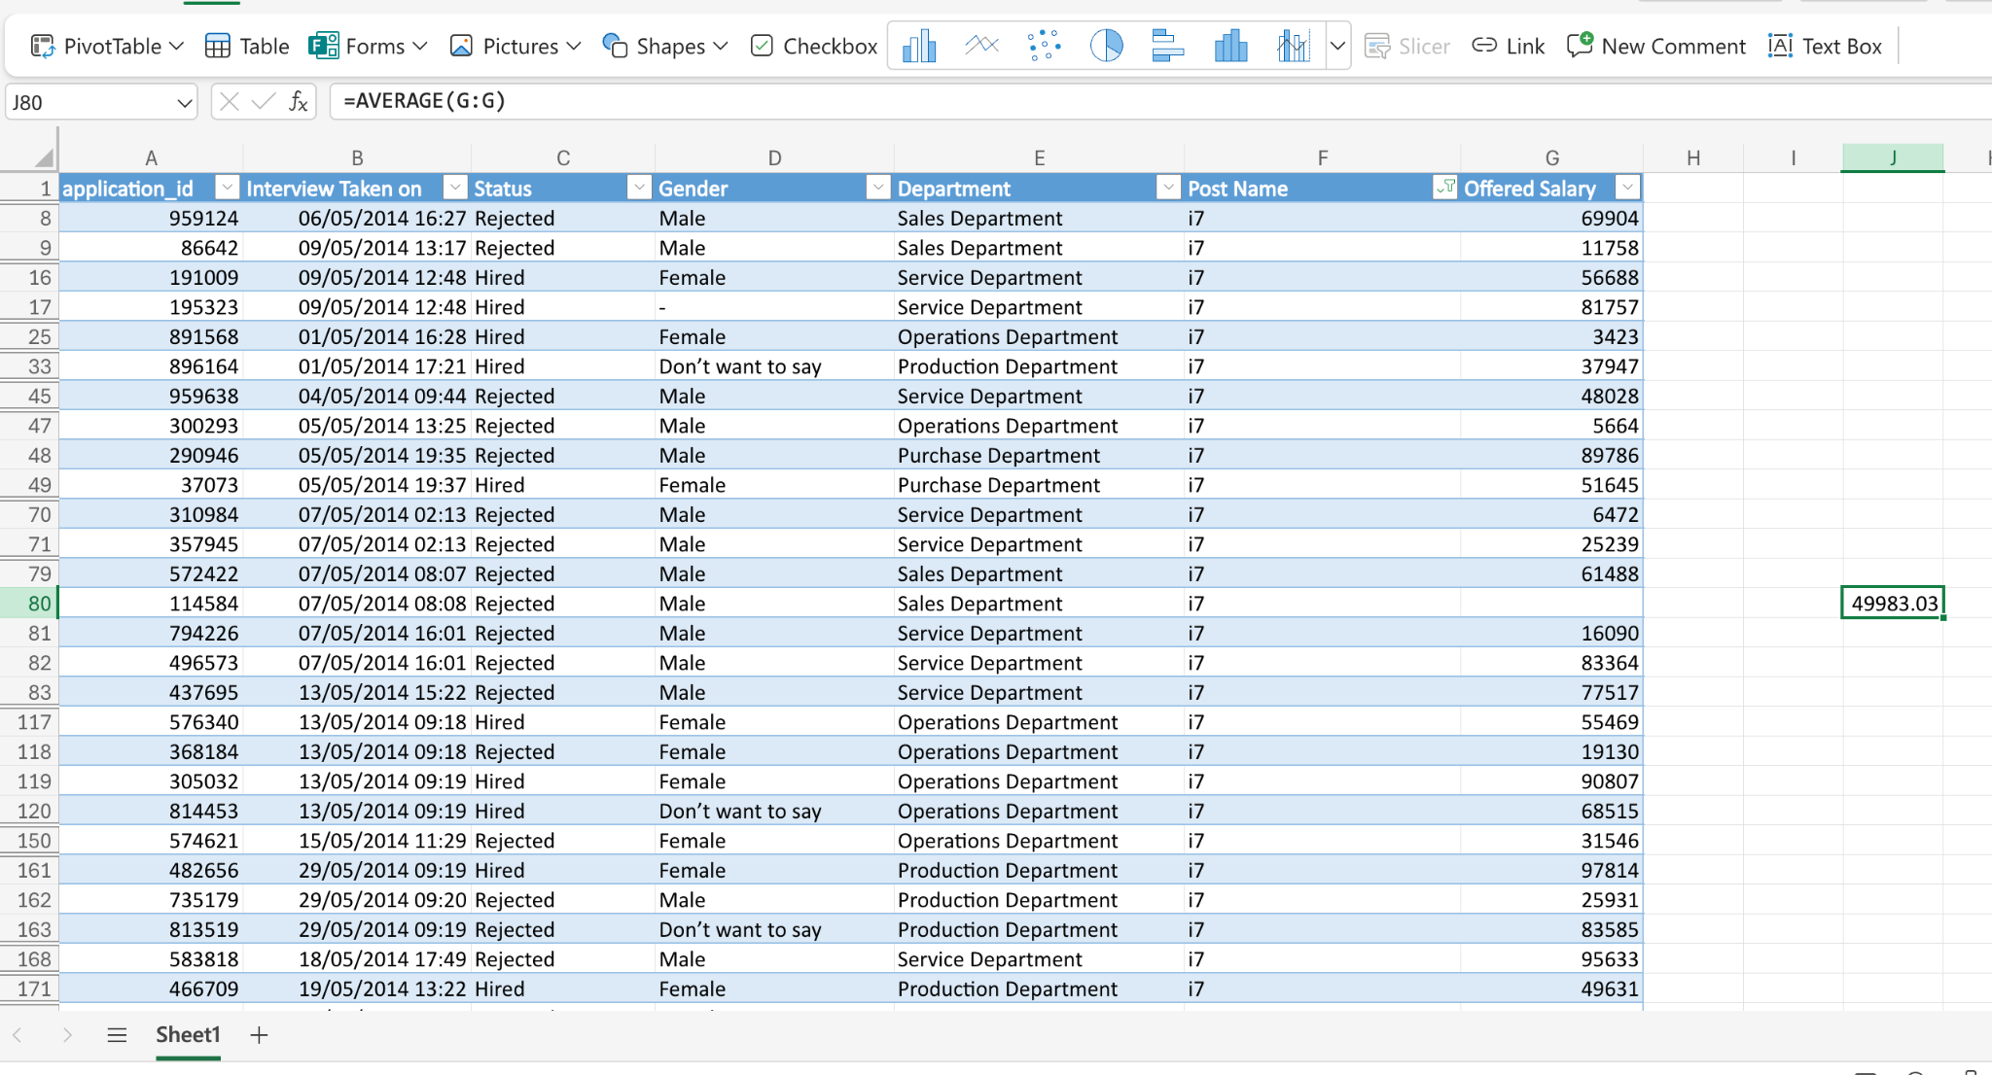
I Checked all columns by setting filters as blank,Found a blank in offered Salary(G80) row.
Inserted the average(mean) value as per post name to standardize.
Changed the column name from event_name to Gender to give proper understanding of data.

Slide 7
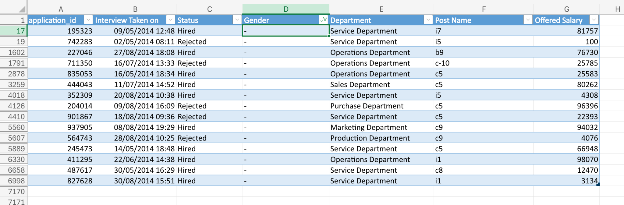
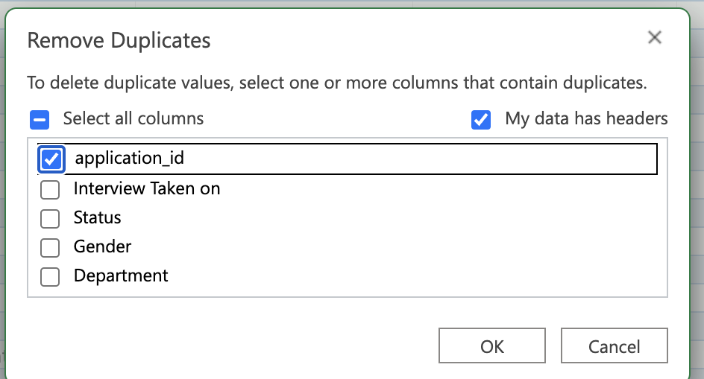
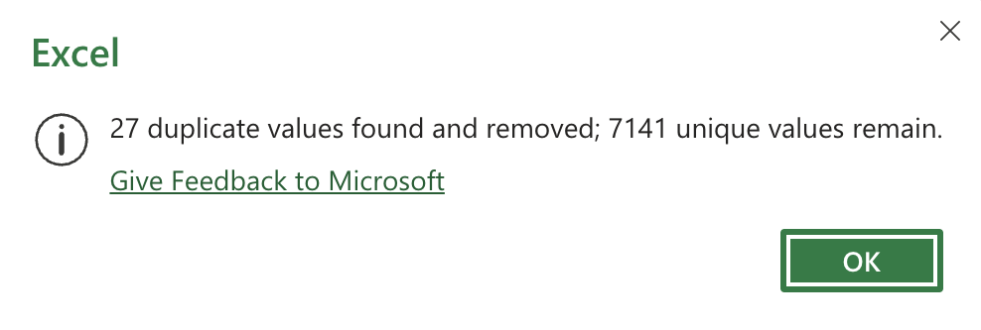
In some columns I found hyphens(-),I filled the data using mode,median of the column.
We know the application_id should be unique,so i deleted the duplicate rows from the table.

Slide 8
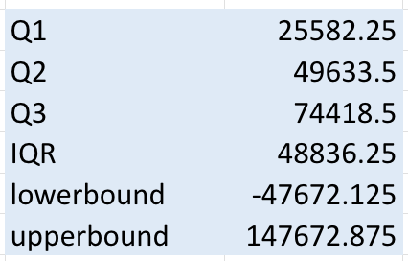
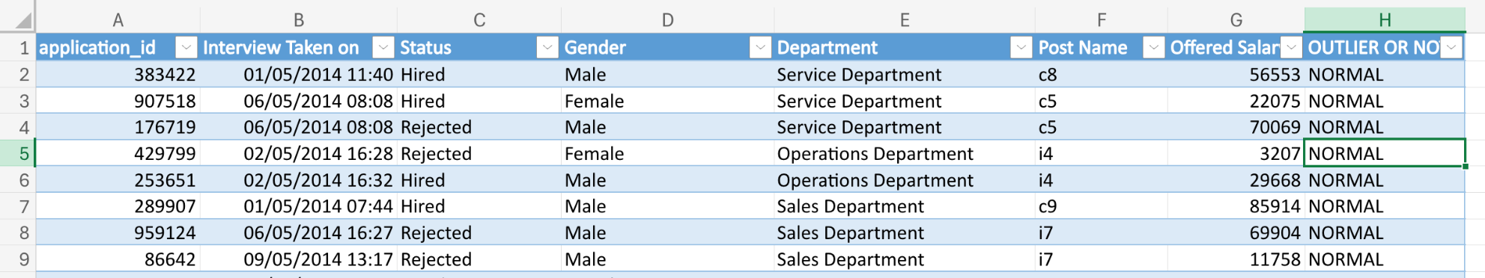
OUTLIER DATA DETECTION:
To detect the outlier data,I have used the formulas to find quartiles.
Q1: =quartile(range,1)
Q2: =quartile(range,2)
Q3: =quartile(range,3)
IQR: =Q3-Q1
Lower bound: Q1-(1.5*IQR)
Upper bound: Q3+(1.5*IQR)
After calculating lower and upper bound,I checked for outlier data by function:
.
I dragged the same formula to total column,then filtered the column with “OUTLIER” and deleted the outlier data rows.

Slide 9
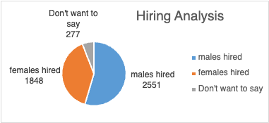
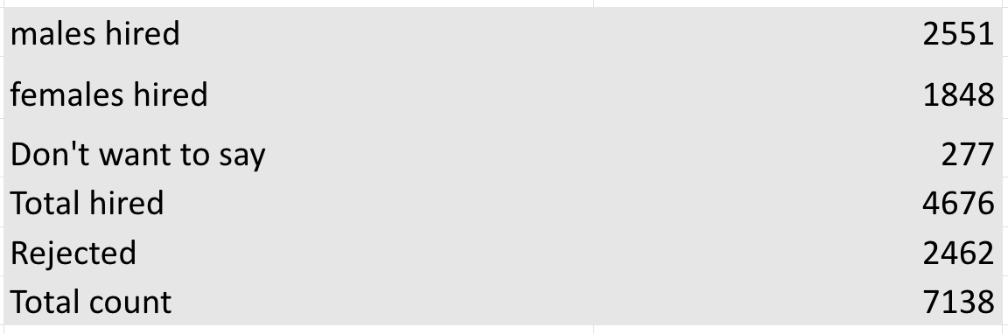
DATA ANALYTIC TASKS:
A. Hiring Analysis:
Determine the gender distribution of hires. How many males and females have been hired by the company?

Slide 10
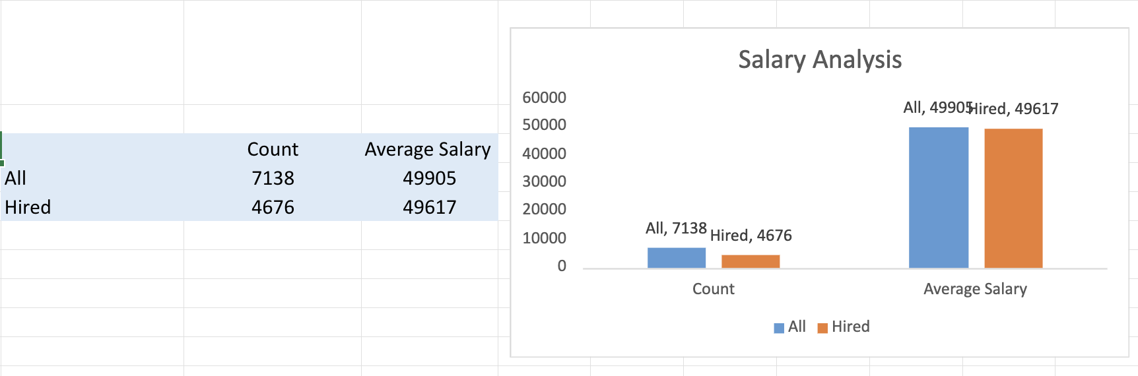
DATA ANALYTIC TASKS:
B. Salary Analysis:
What is the average salary offered by this company? Use Excel functions to calculate this.

Slide 11
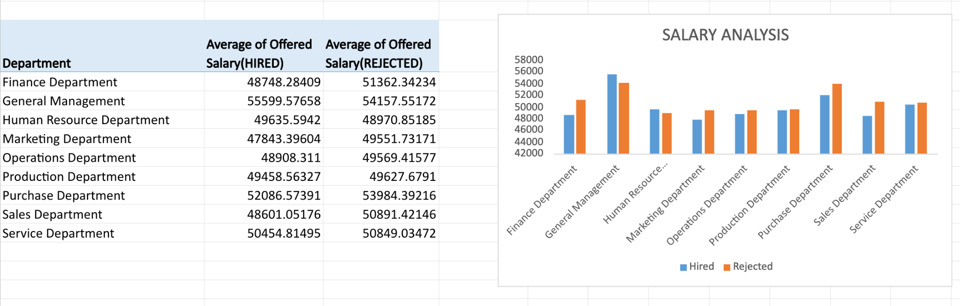
SALARY ANALYSIS DEPARTMENT WISE

Slide 12
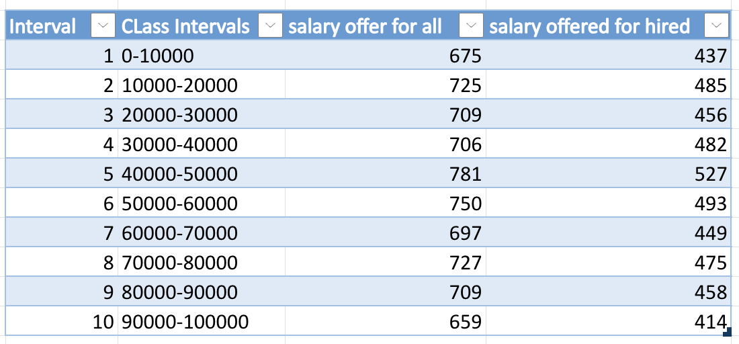
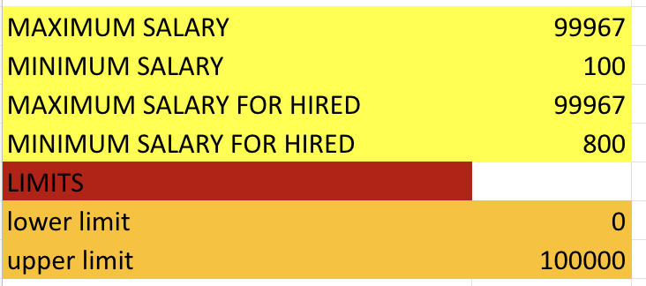
DATA ANALYTIC TASKS:
C. Salary Distribution:
Create class intervals for the salaries in the company. This will help you understand the salary distribution.

Slide 13
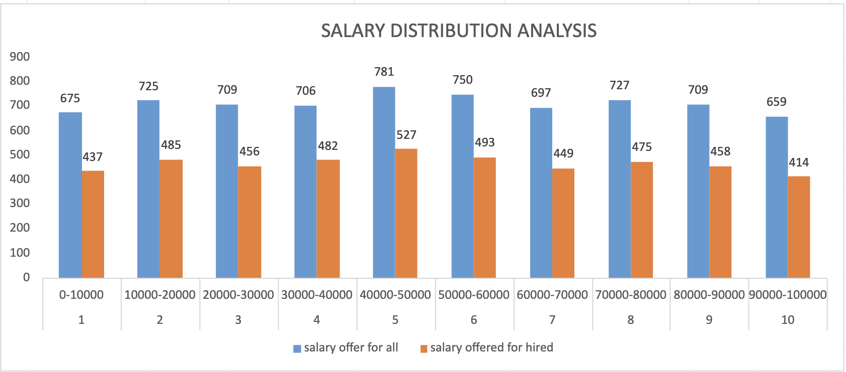
DATA ANALYTIC TASKS:
C. Salary Distribution:
Create class intervals for the salaries in the company. This will help you understand the salary distribution.

Slide 14
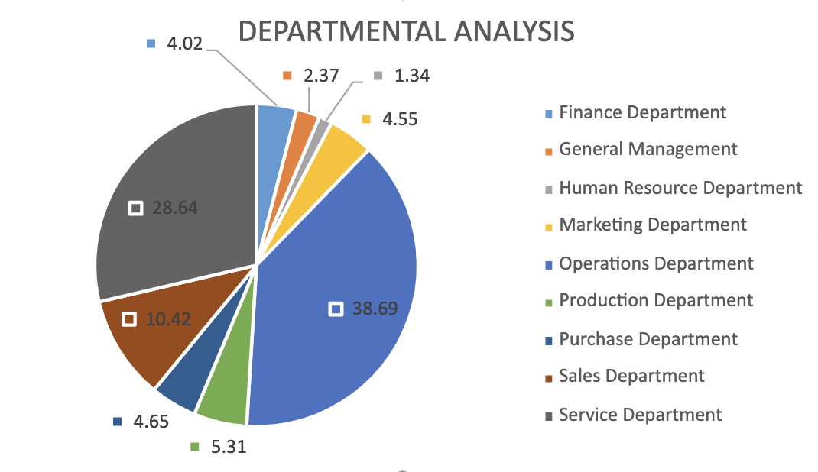
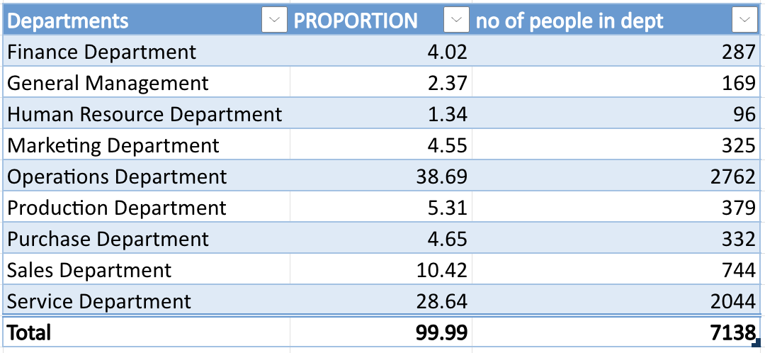
DATA ANALYTIC TASKS:
D. Departmental Analysis:
Use a pie chart, bar graph, or any other suitable visualization to show the proportion of people working in different departments

Slide 15
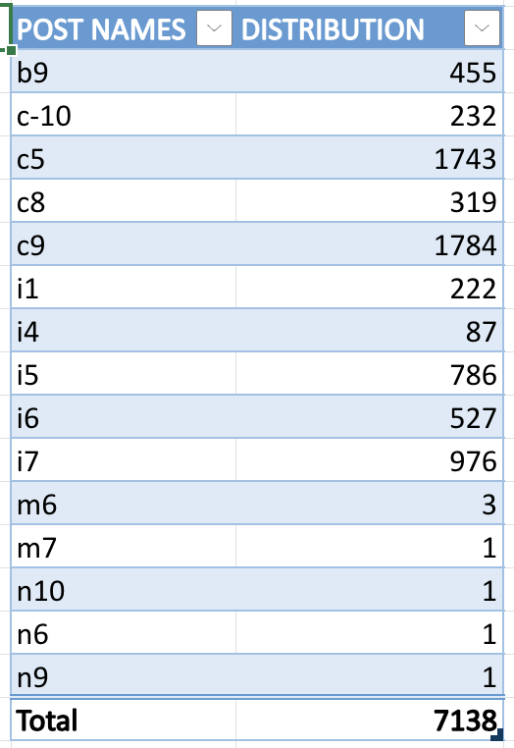
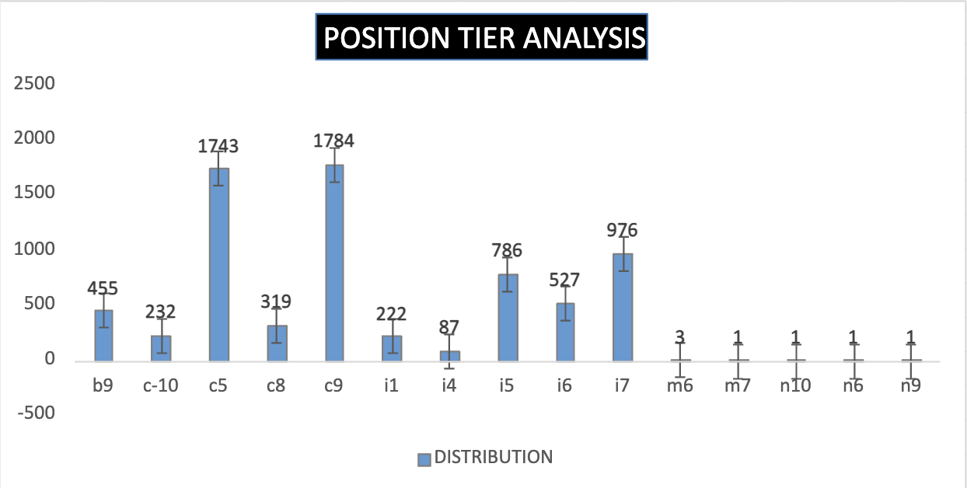
DATA ANALYTIC TASKS:
E. Position Tier Analysis:
Use a chart or graph to represent the different position tiers within the company. This will help you understand the distribution of positions across different tiers.

Slide 16
INSIGHTS:
A. Hiring Analysis: Identified gender distribution among hires to evaluate diversity in recruitment.
B. Salary Analysis: Calculated the average salary offered across different roles and levels to assess pay trends.
C. Salary Distribution: Created salary class intervals to understand income segmentation and salary structure.
D. Departmental Analysis: Examined hiring proportions across various departments to identify workforce allocation trends.
E. Position Tier Analysis: Analyzed the distribution of hires across entry, mid, and senior levels to assess career growth patterns.

Slide 17
RESULT:
By the Project,I have analyzed Hiring Data of a company,and performed data cleaning,preprocessing and analyzed the datasets.
I Identified how salaries are given and distributed,how different genders hired.I used various graphs,charts to give insights
This project had good impact on improving decision making for hiring strategies,salary structuring.

Slide 18
REFERENCE LINK:
The link for excel sheet file:
HIRING PROCESS ANALYTICS.xlsx

Slide 19
THANK YOU

